Slide 2
Project Title
Modelling Static and Dynamic Load Balancing Mechanisms in Edge Computing
Project Guide:
Mr. Amrendra Nath Tripathi
Assistant Professor
Department of Virtualization

Slide 3
MINOR 2
Modelling Static and Dynamic Load Balancing Mechanisms in Edge Computing
NAME | ROLL NO. | SAP-ID | BRANCH | ROLE
Yashvardhan Singh Nathawat | R110218192 | 500068443 | CSE-CCVT B4 | Working on Edge Servers, Workload, capacity management and Round Robin Algorithm
Shubham Bhatnagar | R110218151 | 500069818 | CSE-CCVT B4 | Working on Driver class, Setting connection with servers and Least connection algorithm along with integration
Harsh Upparwal | R110218198 | 500067853 | CSE-CCVT B4 | Working on Task Solutions, testing entire driver class and front end output visualization
Under the guidance of
Mr. Amrendra Nath Tripathi

Slide 4
Introduction
In this project, as a part of design and implementation we have come with a simulation architecture implementing a user node, 3 Edge node, a Load balancer and 1 Data Center and sending tasks between them i.e., from user to Load balancer and it decides on the basis of algorithm used (Round Robin or Least Connection) where to send the task for computation i.e., edge node or the Data Center. The main aim of the load balancer is to schedule tasks on the edge nodes if they have the capacity to compute it, if not then it schedules the task to the data center.
Edge computing is responsible for enhancing the system performance and minimizing the over burden caused at the cloud (in our case 1 data center) by bringing down its service to the user edge. It improves the resources utilization efficiency by using the resources already available at the edge of the network. As a result, it decreases the cloud workload, reduces the latency, and enables a new breed of latency-sensitive applications such as the connected vehicles.

Slide 5
Problem Statement
Overloading of servers-leading to server breakdowns : Introducing Load Balancing Algorithms through a Load balancer in between Client and edge nodes.
Lot of Latency introduced in each task-Leading to lot of delay in response : Introducing Edge Servers with limited but high computational power near to users

Slide 6
Objectives
Objective 1
Studying and grasping the background knowledge related to the Edge Computing and Load Balancing algorithms:
1. Round Robin Load Balancing
2. Least Connection Load Balancing
3. Resource Based Load Balancing
4. Previous works related to Load Balancing
Objective 2
Implement Round Robin algorithm
Objective 3
Implement Least Connection algorithm
Objective 4
Comparing both the algorithms against some workloads and with Edge servers

Slide 7
Software/ Hardware Requirement
SYSTEM REQUIREMENTS
Hardware Interface:
Minimum RAM requirement for proper functioning is 8 GB.
Required input as well as output devices.
Software Interface:
JDK 16
Visual Studio code

Slide 8
Motivation
Cloud computing is a major influencer in the history of edge computing and therefore edge server and computing is something which is new to the market. Edge computing caught our eye due to its involvement in almost every major cloud distributor nowadays like AWS, GCP etc. and also due to its capability to perform computation faster then traditional architecture.
Load balancing on the other hand is something which has been scaled up and used as a major service by almost every architecture nowadays, as it provides extra security and benefits to the servers. So Implementing load balancer for the three servers is the most essential part.

Slide 9
Literature Review
[1] In this paper, the aim is to provide a systematic comparative study of existing load balancing algorithms in cloud computing. It has focused on analyzing various static and dynamic load balancing algorithms with their merits and demerits. It has also addressed the importance of load balancing in the cloud, highlighting the need for dynamic load distribution among the nodes to achieve maximum resource utilization and high user satisfaction ratio.
[2] In this research paper, the various load balancing methods in edge computing are elucidated. A detailed survey of current state-of-the-art load balancing techniques at edge including optimization-based, traffic load-based, heterogeneous, multi-access, joint-load, heuristic, security, allocation, distributed load and the dynamic load-based techniques are explained. It reviewed that dynamic load-based techniques are mostly used in current research whereas CloudSim is a very widely used toolset in the existing research to perform output simulation.

Slide 10
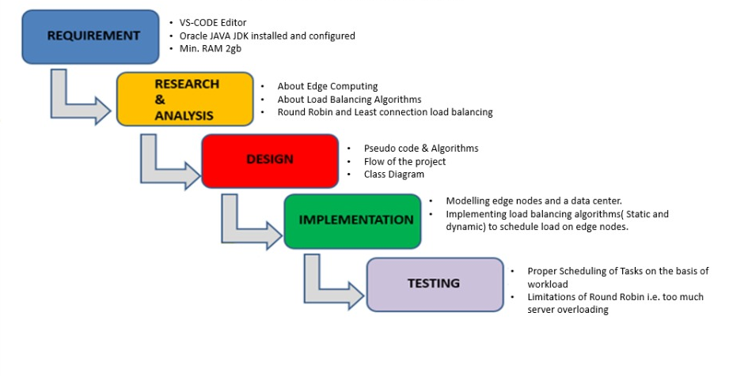
Research Methodology

Slide 11
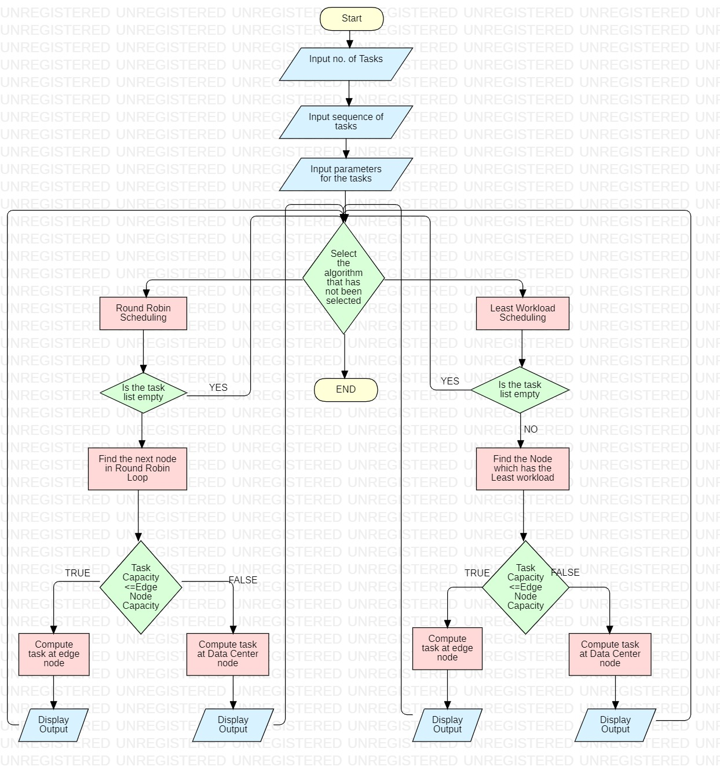
FLOWCHART

Slide 12
Pseudo Code for Load Balancing Algorithms
round_robin(sequence_tasks, parameters_tasks){
//A counter to hold information about next Edge node
int next_edge;
for(i<Size of Sequence Tasks List){
if(task_to_be_performed==1,2,3,4){
Print(Calculating that task)
if(next_edge==1,2,3){
if(capacity_edge_node>=load of task_to_be_performed){
print(Calculating the tast at this edge node)
// Call the evaluate function of next_edge passing task no. and Its parameters List
next_edge.evaluate(task, parameter_list_for_that_task)
//Remove the element from the parameters list as it has been used
update(parameter_list_for_that_task)
//Subtract the load of the task_to_be_performed in the capacity_edge_node
update(capacity_edge_node)
}
else(){
//Call the evaluate function of data_center passing task no. and Its parameters List
data_center.evaluate(task, parameter_list_for_that_task)
//Subtract the load of the task_to_be_performed in the capacity_data_center
update(capacity_data_center)
}
}
}
}
//Update the capacity of all the edge nodes and data centers to original
Update(capacity_edge_node,capacity_data_center);
}

Slide 13
Pseudo Code for Load Balancing Algorithms
least_Workload(sequence_of_tasks, Parameters_for_tasks)
{
// holds the capacity of edgenode
ArrayList<Integer []> maxCapacity
//push the capacity of each edgenode and which edgenoe it is
maxCapacity.add(newInteger[]{ node capacity, which Edge})
for(i=1 -> number of taks in sequence list)
{
//Sort the maxCapacity list and find the edge node which has maximum capacity
Collection.sort(maxCapacity)
If(task_to_be_performed==1,2,3,4)
{
if(maxCapacity.last_element.capacity >= Task_capacity)
{
//evaluate task at edge node mentioned in maxCapacity
evaluateTask();
edgenode_capacity= edgenode_capacity - Task_capacity
}
else{
//evaluate task at data center
evaluateTask();
DataCenter_capacity= DataCenter_capacity - Task_capacity
}
}
}
}

Slide 14
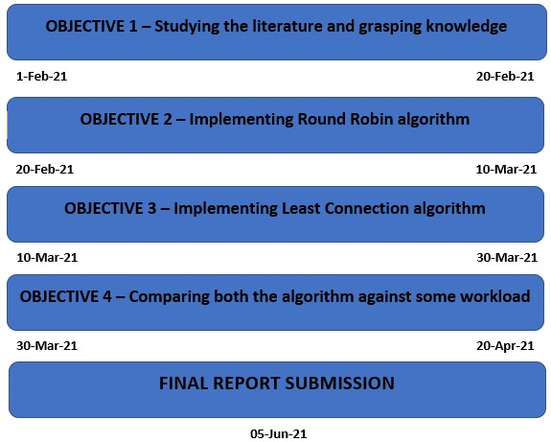
PERT CHART

Slide 15
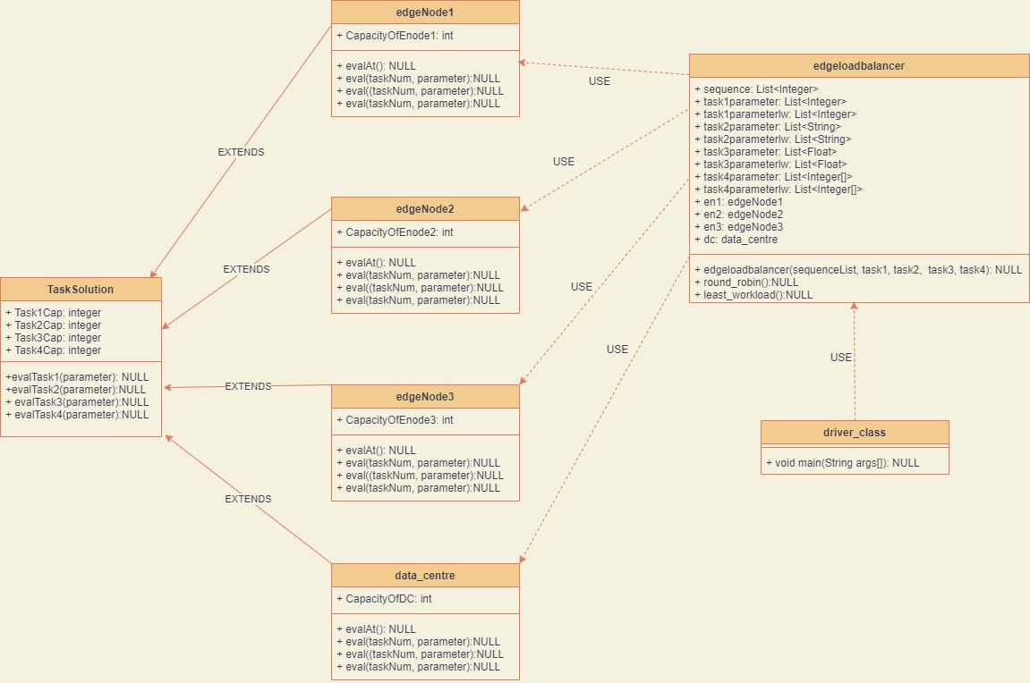
CLASS DIAGRAM

Slide 16
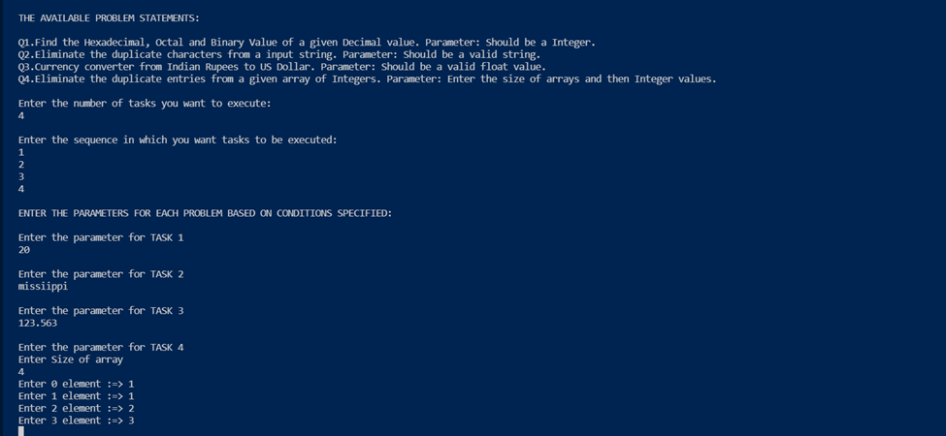
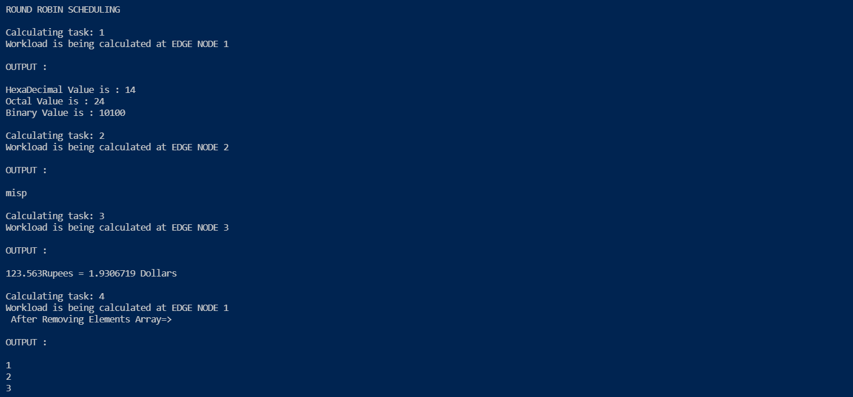
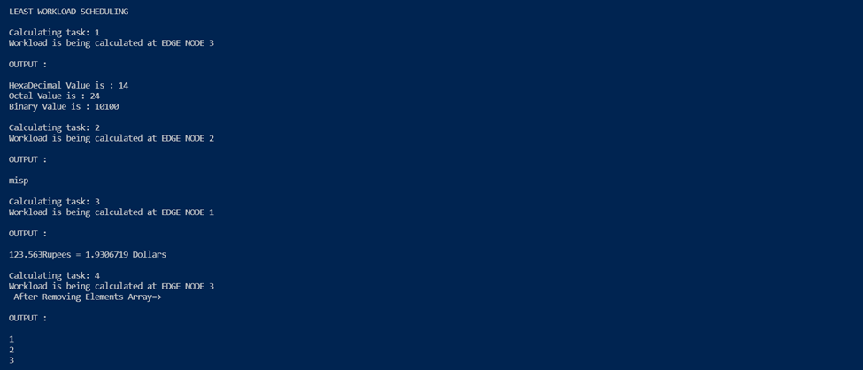
OUTPUT SCREEN

Slide 17
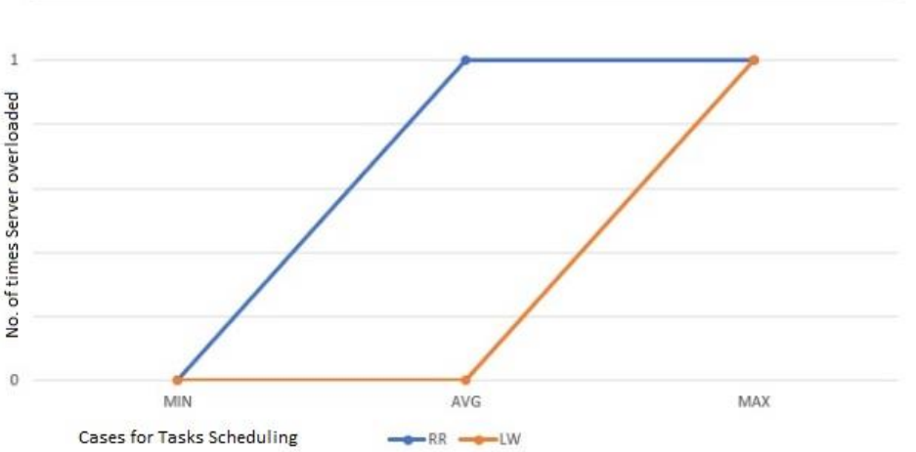
RESULT
x-axis:
MIN-> The program is run by taking all the 4 tasks as the minimum load.
MAX-> The program is run by taking all the 4 tasks as the maximum load
AVERAGE-> The program is run by taking 4 tasks in random order
y-axis:
It depicts the no. of time servers get overloaded when running the cases shown above in
Round Robin and least workload algorithms
By the result shown above and different test cases run by us, we are concluding that round robin load balancing algorithm led to multiple times servers( edge nodes in our demonstration ) getting overloaded and the tasks going to data center. Which leads in the inefficient utilization of edge computing technology.
Whereas, in the case of least connection algorithm the servers are overloaded comparatively very less times and thus letting the tasks to get performed at edge nodes only, thus decreasing the latency caused due to tasks been sent to data center. Also, by involving three Edge Servers in our model we are trying to depict the edge computing technology which is beneficial for fast computation of tasks. And for reducing latency.

Slide 18
References
● [1] T. Deepa, Dr. Dhanaraj Cheelu, “A Comparative Study of Static and Dynamic Load Balancing Algorithms in Cloud Computing” in International Conference on Energy, Communication, Data Analytics and Soft Computing, pp, August 2017
LINK:https://www.researchgate.net/publication/325981627_A_comparative_study_of_static_and_dynamic_load_balancing_algorithms_in_cloud_computing
● [2] Harikrishna Pydi, Ganesh Neelakanta Iyer, “Analytical Review and Study on Load Balancing in Edge Computing Platform” in Fourth International Conference on Computing Methodologies and Communication, pp, 11-13 March 2020
LINK : https://ieeexplore.ieee.org/abstract/document/9076553
● [3] Supriya P Belkar, Vidya Handur, “Comparative Study of Static Load Balancing Algorithms in Distributed System Using CloudSim” in International Journal of Advanced Research in Basic Engineering Sciences and Technology (IJARBEST), Volume 02, Issue 10 (October 2013)
LINK:https://www.ijert.org/comparative-study-of-load-balancing-algorithms-in-cloud-computing-environment
● [4] Karan D. Patel, Tosal M.Bhalodia, “An Efficient Dynamic Load Balancing Algorithm for Virtual Machine in Cloud Computing” in 2019 International Conference on Intelligent Computing and Control Systems (ICCS), pp, 15-17 May 2019
LINK: https://ieeexplore.ieee.org/document/9065292

